Slide 1
Lectures on HPC/Parallel Computing Lecture 1
Andrew Pensoneault

Slide 2
Overview
Introduction to the Argon cluster
Getting Connected
Navigating Linux
Running jobs
Survey

Slide 3
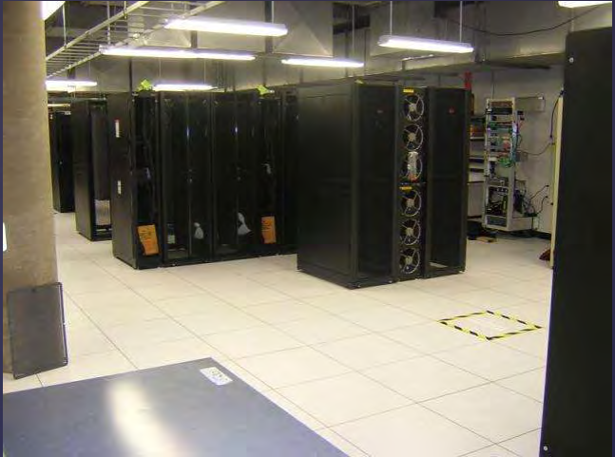
Argon Cluster
High Performance Computing resource at UIowa
Can be though of as a bunch of available computing units which can run many scripts at once
Not necessarily faster than your computer, just more available resource
If you can take advantage of this, it can make running your code much faster

Slide 4
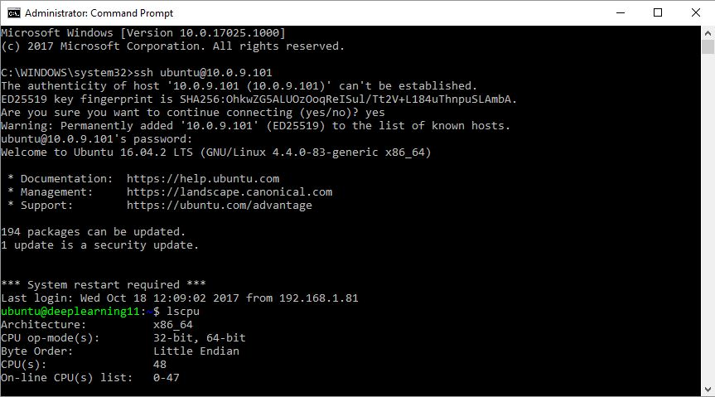
Getting Connected
To access the Argon cluster, you will need an account
I requested access for students enrolled in this course.
To access we will need to ssh in
Your Username will be : <HawkID>
Your Password will be: <HawkIDPassword>

Slide 5
What is ssh
SSH (secure shell) is a protocol for securely networking over an insecure network
SSH allows you to remotely access a computation resource
SSHing into the Argon cluster requires use of the port 22 / port 40 off-campus.
To make use port 22 off campus, we must setup the Cisco AnyConnect VPN

Slide 6
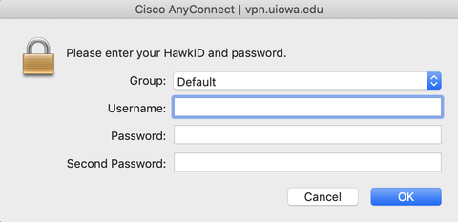
VPn setup
A VPN (Virtual Private Network) allows networking from one network as you were connected to another (e.g. off campus and on campus)
To set this up visit https://its.uiowa.edu/vpn
Download AnyConnect and install
Enter <hawkid> for your username, <hawkidpassword> for your password and <push> for second password for a Duo app

Slide 7
Getting Connected
Both Windows / Mac OS X now include an ssh client
To access open the Command Prompt and run the command (without the $)
$ ssh –p 22 <hawkid>@argon.hpc.uiowa.edu
Answer yes to all prompts, then enter your password
Argon uses 2-factor authentication, so you must have your phone to confirm

Slide 8


Linux and bash
Linux is a family of open-source operating systems based on the Linux kernel.
Bash is a Unix shell that allows for basic job control (read/write files, running programs, piping, etc.)

Slide 9
Relative and absolute location
Absolute paths in Linux are the path starting from the root directory “/”
To get current absolute location, use the command
$ pwd
Relative paths are paths relative to your present working directory “./”
When we do not specify a base directory, we default to “./”
$ cd dir
$ cd ./dir
To specify one level above, we use the symbol “..”
$ cd ..

Slide 10
Relative and absolute location
Your home directory “/Users/<hawkid>/” is given the symbol “~/”
$ cd ~/
When specifying a filename, if no directory information is included, it is assumed to be in “./”
$ rm file1
$ rm ./file1

Slide 11
Navigation in the command line
On login to the cluster, you will be started in the /User/<hawkid>/ directory
To view all files in the current directory, run the command (without the $)
$ ls
To change between directories, you can use the command
$ cd [dir]
There are additional flags for all these commands, to learn the type
$ man <command>

Slide 12
Navigation in the command line
To make a directory use the command
$ mkdir <dirname>
To remove a file (not a directory), use the command
$ rm <filename>
To remove a directory and its contents, include the flag –r (be careful)
$ rm -r <dirname>
To move (or rename) a file/directory and its contents,
$ mv <filename> <newlocation>

Slide 13
Navigation in the command line
To copy files, use the following command
$ cp <filename> <newfilename>

Slide 14
Text editor
There are many text editors in Linux
I will teach the basics of vim
To make a file, use the command
$ vi <filename>
To start typing mode, press “i”
To exit typing mode, press “esc”
To save, exit typing mode, and press “:w”
To save and quit, exit typing mode, and press “:wq”

Slide 15

Basic Job submission
In order to submit a job, you must make a sh file, specifying what the job will do
To make a file, use the command
$ vi <filename>
Create a file helloworld.sh
To run locally, use
$ sh helloworld.sh
To submit the job, run
$ qsub helloworld.sh

Slide 16
Transferring with SCP
From your local computer, we can transfer to a remote directory using the scp command just like ssh
$ scp –P 22 <localfile> <hawkid>@argon.hpc.uiowa.edu:<remotefile>
This can also be done with an sftp client, we will discuss this briefly next time
You can use WinSCP if on Windows https://winscp.net/eng/index.php

Slide 17
Running your code
To run a matlab script named “main.m”, inside an sh file in the same directory write the following command
module load matlab
matlab -nodisplay -nosplash -r ‘main’
To run a python script named “main.py”, inside an sh file in the same directory write the following command
module load python
python main.py
To run a Julia script named “main.jl”, inside an sh file in the same directory write the following commands
module load julia
julia main.jl

